Slide 1

Errors, Naïve Bayes, and Decision Trees
David Quigley
CSCI 5622
2021 Fall

Slide 2
Course Checkup
HW 1 is out! It will run through an autograder, so…
keep all predefined functions with the same input / output options
You can add arguments with defaults
If a function doesn’t have given return values, you can add them (usually in report functions)
Generalize your code
We should never have to, e.g., comment / uncomment code to get it to run
Project Updates
Posting welcome on Piazza (due Now) - Counting in weekly participation
Group Formation Due Sept. 10 - All group members upload identical document
Course Zoom is not “drop-in”
Feel free to use it – but I won’t show up unless scheduled

Slide 3
Project Groups
Forming Groups – up to 3 people maximum
Recommended 2 – 3 people
If you want to be solo, you need to seek permission at this group formation
Starting to Form Problem Spaces / Datasets
This is not “set in stone” – things can change!
These are not “research” – we are finding public, accessible datasets or working with data you already have access to!*
You can “double dip” your course project (with other courses, lab research, work, etc)
You will have to connect me with the other people and delineate what expectations and deliverables are for which purposes
*If you want to establish a new dataset via this class, we can talk!

Slide 4
Project Group Formation
I (or the ISS) tried to comment on everyone’s welcome (as of this afternoon)
If you gave an interest, background experience, or related idea, I tried to tie it into project inspiration!
This does not mean you have to go down that path at all with your projects.
Lots of folks probably shouldn’t…
There are a lot of connections between folks!
A lot of outdoors enthusiasts, a lot of sports fans, a lot of video game players, a lot of readers…
A lot of folks interested in NLP, a lot interested in CV, several interested in Space as a… problem space…
Any of these can inspire a project or more!

Slide 5

Prediction – College Admission
What are you going to predict for this NEW case with K = 1, using Manhattan distance?
Student | X₁ | X₂ | Y
A | 1200 | 26 | 1
B | 1450 | 28 | 1
C | 1000 | 20 | 1
D | 730 | 15 | -1
NEW | 720 | 16 | ???

Slide 6
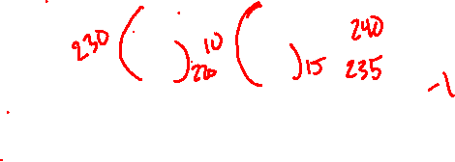
Prediction – College Admission
What are you going to predict for this NEW case with K = 1, using Manhattan distance?
Student | X₁ | X₂ | Y
A | 1200 | 26 | 1
B | 1450 | 28 | 1
C | 1180 | 20 | 1
D | 730 | 15 | -1
NEW | 950 | 30 | ???

Slide 7
Euclidian Distance – N-Dimensional Vector
Euclidian Distance: ||x_{i} – x||²
X₁ | X₂ | X₃ | X₄ | Y | Distance
2 | 5 | 9832 | .005 | Positive
4 | 82 | 9421 | .008 | Positive
3 | 17 | 9321 | .04 | Negative
4 | 90 | 9128 | .001 | Negative

Slide 8
Euclidian Distance – N-Dimensional Vector
Euclidian Distance: ||x_{i} – x||²
X₁ | X₂ | X₃ | X₄ | Y | Distance
2 | 5 | 9832 | .005 | Positive
4 | 82 | 9421 | .008 | Positive
3 | 17 | 9321 | .04 | Negative
4 | 90 | 9128 | .001 | Negative
3 | 16 | 9830 | .04 | ???

Slide 9
Euclidian Distance – N-Dimensional Vector
Euclidian Distance: ||x_{i} – x||²
X₁ | X₂ | X₃ | X₄ | Y | Distance
2 | 5 | 9832 | .005 | Positive | 126.001
4 | 82 | 9421 | .008 | Positive | 171638.001
3 | 17 | 9321 | .04 | Negative | 259082
4 | 90 | 9128 | .001 | Negative | 498281.0015
3 | 16 | 9830 | .04 | ???

Slide 10

Euclidian Distance – N-Dimensional Vector
Euclidian Distance: ||x_{i} – x||²
X₁ | X₂ | X₃ | X₄ | Y | Distance
2 | 5 | 9832 | .005 | Positive | 126.001
4 | 82 | 9421 | .008 | Positive | 171638.001
3 | 17 | 9321 | .04 | Negative | 259082
4 | 90 | 9128 | .001 | Negative | 498281.0015
3 | 16 | 9830 | .04 | Positive?

Slide 11
Normalization / Scaling
Transform X (Data) to X’ (Scaled Data)
For (x_{i}) in X
scale = max(x_{i}) – min(x_{i})
For (x_{i,j}) in (x_{i})
x’_{i,j} = (x_{i,j} – min(x_{i})) / scale

Slide 12

Scaling – N-Dimensional Vector
Euclidian Distance: ||x_{i} – x||²
X₁ | X₂ | X₃ | X₄ | Y | Distance
0 | 0 | 1 | 0.103 | Positive | 1.07
1 | 0.906 | 0.416 | 0.179 | Positive | 1.87
.5 | 0.141 | 0.274 | 1 | Negative | 0.52
1 | 1 | 0 | 0 | Negative | 3.00
.5 | 0.129 | 0.997 | 1 | Negative

Slide 13
Scaling – College Prediction
Student | SAT | ACT | GPA | Graduated?
A | 1200 / 1600 | 26 / 36 | 3.2 / 4.0 | Yes
B | 1450 / 1600 | 28 / 36 | 3.5 / 4.0 | Yes
C | 1000 / 1600 | 20 / 36 | 3.0 / 4.0 | Yes
D | 730 / 1600 | 15 / 36 | 2.0 / 4.0 | No
NEW | 720 / 1600 | 16 / 36 | 2.2 / 4.0 | ???

Slide 14
Scaling – Housing Market?
Euclidian Distance: ||x_{i} – x||²
# Bedrms | Acres | Sq. Ft. | Radon | New Build? | Distance
2 | 5 | 9832 | .005 | Positive
4 | 82 | 9421 | .008 | Positive
3 | 17 | 9321 | .04 | Negative
4 | 90 | 9128 | .001 | Negative

Slide 15

Normalization / Scaling
Normalization is important for us to consider
- It will allow us to consider variables on equal footing
Normalization and Scaling are important for us to consider on a case by case basis
- Sometimes a “default” transformation won’t make sense

Slide 16
Working with the built-in KNN library
Open Week 1 in-class Jupyter Notebook (the .ipynb file from Canvas)

Slide 17
K-Nearest Neighbors Algorithmic Complexity
One Query, m training examples, each with D features
O(m*D)
For the Naïve Case
Scikit-learn has additional details in their implementation: https://scikit-learn.org/stable/modules/neighbors.html

Slide 18
K-Nearest Neighbors Algorithmic Complexity
How many different operations must I complete to find the 1 nearest neighbor?
How many different operations must I complete to find the 5 nearest neighbors?

Slide 19
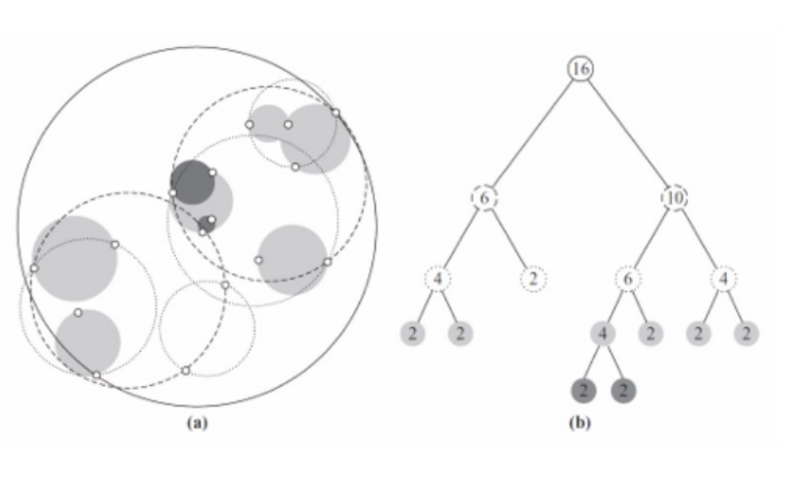
K-Nearest Neighbors – Tree Structure

Slide 20
Evaluating Models

Slide 21
How do we know if it works?

Slide 22
Homework 1 – Training & Test Sets
Train Data
I pull out a random 20% of my data
Now I have something (probably) representative, AND
I’m not just testing inherent bias of my model or dataset
Test Data

Slide 23
What is an Error?
We’ve looked at trying it out on a test set and getting an “accuracy”
Accuracy = # correct / # total
What is our “test set”?
Are all mistakes created equal?

Slide 24
Types of Errors
Classified As Ground Truth | C | ~C
C
~C

Slide 25
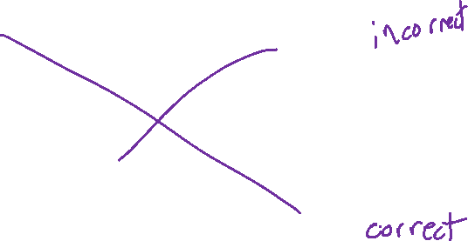
Types of Errors
Classified As Ground Truth | C | ~C
C | True Positive (Hit) | False Negative (Miss)
~C | False Positive (False Alarm) | True Negative (Correct Rejection)

Slide 26
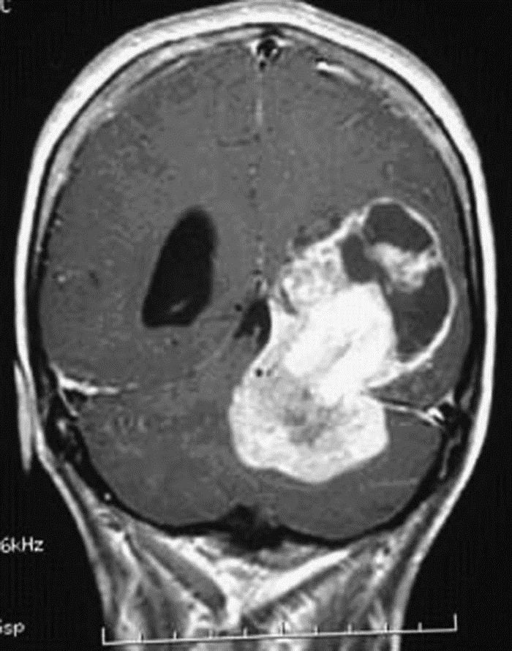
What makes an error?

Slide 27
Types of Errors
Classified As Ground Truth | Cancer | Not Cancer
Cancer | True Positive (Hit) | False Negative (Miss)
Not Cancer | False Positive (False Alarm) | True Negative (Correct Rejection)

Slide 28
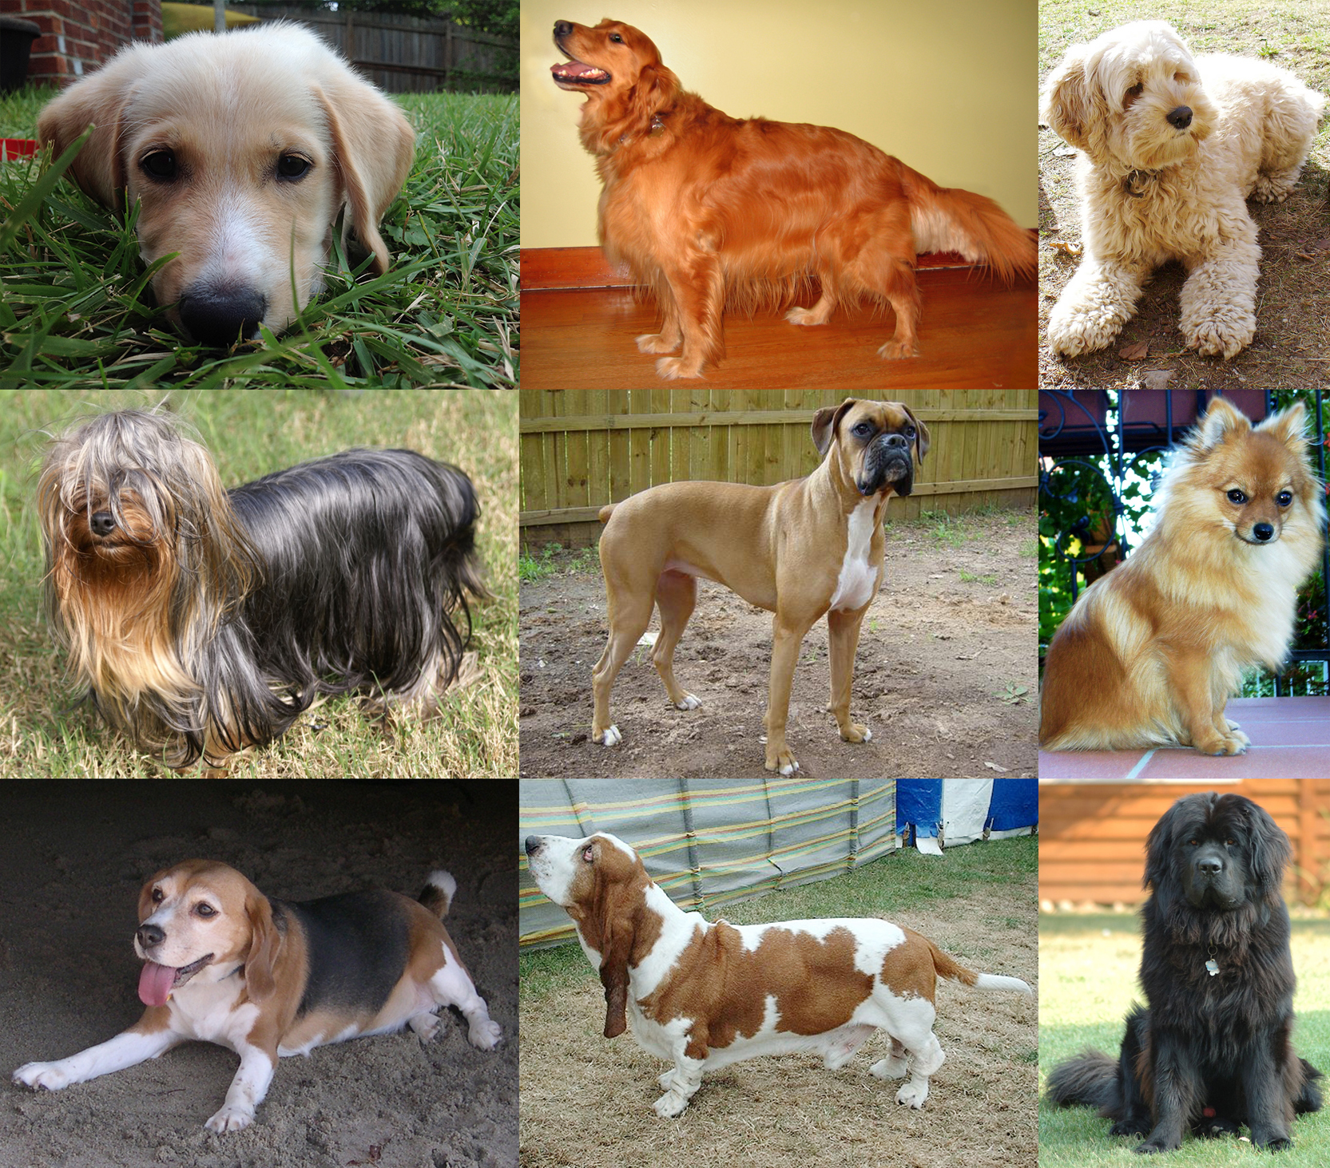
Types of Errors

Slide 29
Types of Errors
Classified As Ground Truth | A | B | C
A
B
C

Slide 30
Types of Errors
Classified As Ground Truth | A | B | C
A | hit | miss | miss
B | miss | hit | miss
C | miss | miss | hit

Slide 31
Types of Errors
Classified As Ground Truth | C | ~C
C | True Positive (Hit) | False Negative (Miss)
~C | False Positive (False Alarm) | True Negative (Correct Rejection)

Slide 32
Calculating Errors
Error = 1/n * ∑_{i=1→n}(I(ŷ_{i} ≠ y_{i}))
# errors / # instances
Is this always helpful? Meaningful?

Slide 33
Errors
Skewed Classes
- Classifying a day of sun in Yuma, AZ (308 sunny days / year)
my classifier - isSunny = true

Slide 34
Errors
Skewed Classes
- Classifying a day of sun in Yuma, AZ (308 sunny days / year)
my classifier - isSunny = true
84 % Accuracy
- What if it’s a case with 98% in one class?
Is 98.5% accuracy helpful?

Slide 35
Errors
Skewed Classes
- Classifying a day of sun in Yuma, AZ (308 sunny days / year)
my classifier - isSunny = true
84 % Accuracy
- What if it’s a case with 98% in one class?
Is 98.5% accuracy helpful?
Are all errors created equal?

Slide 36
Are all errors created equal?
Truth – No Cancer Truth – Cancer
Classified Cancer Classified No Cancer

Slide 37
Are all errors created equal?
Truth – No Cancer Truth – Cancer
Classified Cancer Classified No Cancer
Goes to get a new Moves on with their
test – more expensive day. Does not
but more accurate. pursue treatments.
Discovers true status. Cancer worsens.

Slide 38
Types of Errors
Predicted Positive Rate (Precision) = Hits / (Hits + False Alarm)
Classified As Ground Truth | C | ~C
C | True Positive (Hit) | False Negative (Miss)
~C | False Positive (False Alarm) | True Negative (Correct Rejection)

Slide 39
Types of Errors
Predicted Negative Rate (Negative Predictive Value) = Corr. Rej / (Miss + Corr. Rej.)
Classified As Ground Truth | C | ~C
C | True Positive (Hit) | False Negative (Miss)
~C | False Positive (False Alarm) | True Negative (Correct Rejection)

Slide 40
Types of Errors
True Positive Rate (Sensitivity, Recall) = Hits / (Hits + Miss)
Classified As Ground Truth | C | ~C
C | True Positive (Hit) | False Negative (Miss)
~C | False Positive (False Alarm) | True Negative (Correct Rejection)

Slide 41
Types of Errors
False Positive Rate (Specificity) = Corr. Rej. / (False Alarm + Corr. Rej.)
Classified As Ground Truth | C | ~C
C | True Positive (Hit) | False Negative (Miss)
~C | False Positive (False Alarm) | True Negative (Correct Rejection)

Slide 42
Confusion Matrix
Classified As Ground Truth | C | ~C
C | Count of True Positives (Hit) | Count of False Negatives (Miss)
~C | Count of False Positives (False Alarm) | Count of True Negatives (Correct Rej.)

Slide 43



Confusion Matrix – Beyond Binary Decisions
https://en.wikipedia.org/wiki/Iris_flower_data_set

Slide 44
Confusion Matrix
Classified As Ground Truth | C | ~C
C | Count of True Positives (Hit) | Count of False Negatives (Miss)
~C | Count of False Positives (False Alarm) | Count of True Negatives (Correct Rej.)

Slide 45
Confusion Matrix
Classified As Ground Truth | A | B | C
A | Count of A / A Hits | Count of B / A Misses | Count of C / A Misses
B | Count of A / B Misses | Count of B / B Hits | Count of C / B Misses
C | Count of A / C Misses | Count of B / C Misses | Count of C / C Hits

Slide 46
Problem Set 1
You now have everything you need to work through Problem Set 1!

Slide 47

Problem Space – College Admissions (Week 1)
The following scenario isn’t fully true, but it’s close to what we do in college admissions…
I am trying to decide if a student should be admitted to my university. I have their SAT and ACT scores and their HS GPA. I also have the history of students who have attended in the past, their SAT / ACT / HS GPA as well as whether or not they graduated. I only want to admit new students if they will graduate.

Slide 48
Problems We Faced

Slide 49
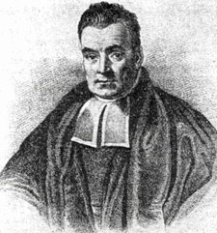
Naïve Bayes

Slide 50
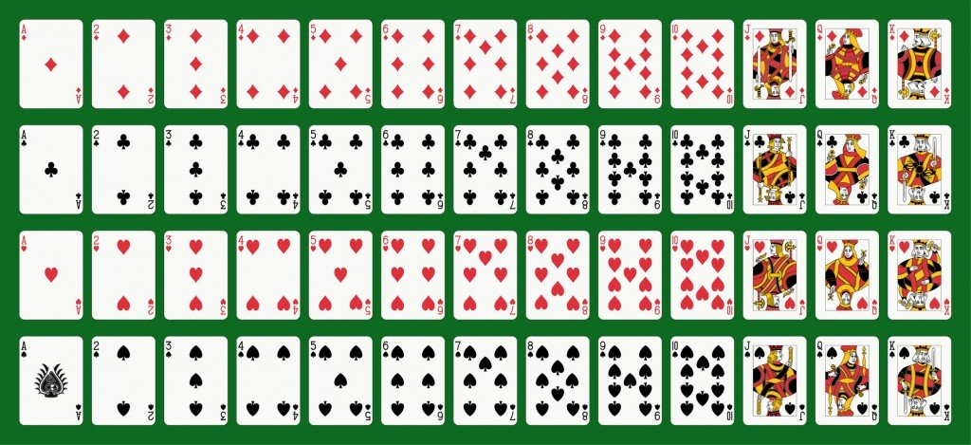
Probability Refresher (see Add’l Reading)
52 Cards
2 Colors {Red, Black}
4 Suits {D,C,H,S}
13 Values {A,2,3,…K}
Notes:
https://www.scienceabc.com/wp-content/uploads/2016/05/Fotolia_23299310_Subscription_Monthly_M.jpg

Slide 51

Probability Refresher
V – Random variable of Value
v = “ace”, v = 7, etc.
p(v) = probability that card has value “v”
C – Random variable of Color
C = Red or C = Black
p(c) = probability that card has color “c”
Joint probability – probability of multiple events simultaneously
p(v,c) = probability that card has value “v” and color “c”
probability of a Red 7 can be written as p(v=7,c=red) or p(7,red)

Slide 52
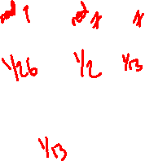
Probability Refresher – Product Rule
Product rule: p(A,B) = p(A|B)*p(B) = p(B|A)*p(A)
The Joint probability is equal to to the conditional probability multiplied by the probability of the condition (the marginal probability).
p(C,V) = p(C|V)*p(V) = p(V|C)*p(C)
P(Red,7) =
p(Red) =
P(7) =
p(Red,7) =

Slide 53
Probability Refresher – Chain Rule
For three variables, A,B,C, we can use the Product Rule repeatedly to show:
p(A,B,C) = p(a) * p(b|a) * p(c|b,a)
For i random variables X_{1:I}, we have:
p(X_{1:i}) = p(X₁) * p(X₂|X₁) * … * p(X_{i}|X_{1:i-1})
Proving the Chain Rule is left as an exercise for the interested student

Slide 54
Probability Refresher – Sum Rule
Conversely, if we know the joint probabilities, we can compute the marginal.
p(A) = ∑_{b}p(A,B=b) = ∑_{b}p(A|B=b) * p(B=b)
Given p(C=Red,V=7) and p(C=Black,V=7), calculate p(V=7)

Slide 55
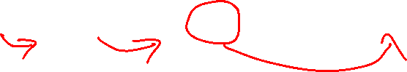
Probability – Bayes Rule
p(A,B) = p(A|B)*p(B) = p(B|A)*p(A)
p(X,Y) = p(Y|X)*p(X) → p(Y|X) = p(X,Y) / p(X) $→ p(Y|X) = (p(X|Y)*p(Y)) / p(X)
p(Y|X) = p(X|Y)*p(Y)
p(X)
$ = assuming p(X) > 0 (i.e. our data is possible)

Slide 56
Probability – Bayes Rule + Sum Rule
If we evaluate the
p(Y = y|X = x) = p(X = x | Y = y)*p(Y = y)
p(X = x)
And we use the sum rule…
p(Y = y|X = x) = p(X = x | Y = y)*p(Y = y)
∑_{y’}p(X=x|Y=y’) * p(Y=y’)
We can compute p(y|x) from nothing but p(x|y) and p(y)

Slide 57
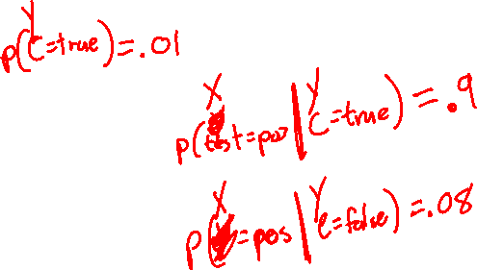
Bayes Rule - Cancer
We have a Cancer Test = {pos,neg} and Cancer {C,~C}
1% of people have cancer
90% of people with cancer will test positive
8% of people without cancer will test positive

Slide 58

Bayes Rule - Cancer
Say you have a positive test. What is the probability that you have cancer?
p(C | pos)

Slide 59
Thursday

Slide 60
Course Check-In
Problem Set 1
You will turn in your Jupyter Notebook (.ipynb file)
You’ll submit “after a completed run” – so we’ll see the graphs you just generated, etc.
Your text descriptions should be generalized, but can reference those specific plots
Project Group Formation
Post available on Piazza – “Search for Teammates!” is a great place to start

Slide 61
Bayes Rule - Cancer
We have a Cancer Test = {pos,neg} and Cancer {C,~C}
1% of people have cancer
90% of people with cancer will test positive
8% of people without cancer will test positive

Slide 62
Bayes Rule - Cancer
Say you have a positive test. What is the probability that you have cancer?
p(C | pos)

Slide 63
Bayes Rule - Cancer
Say you have a positive test. What is the probability that you have cancer?
p(C | pos)
Can’t ignore the fact that there’s a small percentage of people with cancer
p(C) = 0.01

Slide 64
Bayes Rule - Cancer
p(C|pos) = p(pos|C)*p(C) as our formulation
p(pos|C)*p(C) + p(pos|~C)*p(~C)

Slide 65
Bayes Rule - Cancer
p(C|pos) = .90*.01 = .10
.90 * .01+ .08 * .99

Slide 66
Naïve Bayes Classification
We want to model the joint probability: p(x,y)
What we actually care about is the probability of our answer given the data: p(y|x)
p(Y|X) = p(X|Y)*p(Y)
p(X)
Or…
Posterior probability = class-conditional * prior
evidence

Slide 67
Naïve Bayes Classification
“What is the possibility that an example is of class c given its observed features?”
- What is the probability it is a grad (pos) given its HS outcomes?
Given a HS x:
If p(pos | x) >= p(neg | x)
classify as pos
Else
classify as neg

Slide 68
Class-conditional probability p(X | Y)
i.e. “Likelihood”
“Given (or assuming) y = c, what is the probability x is observed?”
“Given my assumptions about failing students, what’s the probability that I see this particular student?”
p(x = [GPA=1.2,SAT=550] | y = neg)
NOTE: Now we’re assuming joint probability of features

Slide 69
Naïve Bayes – Assumption of Independence
Features of x are conditionally independent for a given class y.

Slide 70
Naïve Bayes – Assumption of Independence
Features of x are conditionally independent for a given class y.
Take two weighted coins, C₁ and C₂.

Slide 71
Naïve Bayes – Assumption of Independence
Features of x are conditionally independent for a given class y.
Take two weighted coins, C₁ and C₂.
Pick a coin and flip it 3 times. Which coin did we flip?
p(x=[HHT] | C₁) = p(H|C₁) * p(H|C₁) * p(T|C₁)
Vs
p(x=[HHT] | C₂) = p(H|C₂) * p(H|C₂) * p(T|C₂)

Slide 72
Naïve Bayes – Assumption of Independence
Features of x are conditionally independent for a given class y.
Take two weighted coins, C₁ and C₂.
Pick a coin and flip it 3 times. Which coin did we flip?
p(x=[HHT] | C₁) = p(H|C₁) * p(H|C₁) * p(T|C₁)
Vs
p(x=[HHT] | C₂) = p(H|C₂) * p(H|C₂) * p(T|C₂)
Draw 3 cards from a deck of cards, one at a time (no replacement). Does this still hold?

Slide 73
Naïve Bayes – Assumption of Independence
Features of x are conditionally independent for a given class y.
p(x=[GPA=1.2,SAT=550,ACT=21] | neg) = p(GPA=1.2 | neg) * p(SAT=550| neg) * p(ACT=21 | neg)
Is this valid?
Probably not, but a) we’ll make the assumptions for both pos and neg, and b) it makes feature conditionals easy to estimate

Slide 74

Naïve Bayes – Class-Conditional Probability
Features of x are conditionally independent for a given class y.
p(x=[GPA=1.2,SAT=550,ACT=12] | neg) = p(GPA=1.2| neg) * p(SAT=550| neg) * p(ACT=21 | neg)
How do we calculate the class-conditional probability?
Estimate from Data!
P(GPA=1.2| neg) = # failing students with a HS GPA of 1.2
# failing students

Slide 75
Naïve Bayes Classification
We want to model the joint probability: p(x,y)
What we actually care about is the probability of our answer given the data: p(y|x)
p(Y|X) = p(X|Y)*p(Y)
p(X)
Or…
Posterior probability = class-conditional * prior
evidence

Slide 76

Prior Probability p(y)
“What is the probability of encountering class c?”
p(neg) = “What is the probability that any given student will fail?”
How do we get this information?

Slide 77
Prior Probability p(y)
“What is the probability of encountering class c?”
p(neg) = “What is the probability that any given student will fail?”
How do we get this information?
Ask Someone Who Knows!
Assume 80% of students fail
this class assumption does not necessarily match the real world!

Slide 78
Prior Probability p(y)
“What is the probability of encountering class c?”
p(neg) = “What is the probability that any given student will fail?”
How do we get this information?
Estimate it from Data!
P(neg) = # failing students
# students

Slide 79
Naïve Bayes Classification
We want to model the joint probability: p(x,y)
What we actually care about is the probability of our answer given the data: p(y|x)
p(Y|X) = p(X|Y)*p(Y)
p(X)
Or…
Posterior probability = class-conditional * prior
evidence

Slide 80
Evidence p(x)
“The probability of encountering x independent of class”
“the probability of getting that exact HS outcome”
We could estimate this using the sum rule…

Slide 81
Naïve Bayes Classification
“What is the possibility that an example is of class c given its observed features?”
- What is the probability it is a positive grad given its HS features ?
Given HS features x:
If p(pos | x) >= p(neg | x)
classify as pos
Else
classify as neg

Slide 82
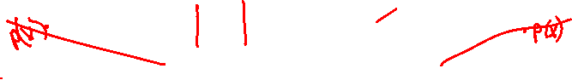
Evidence p(x)
“The probability of encountering x independent of class”
“the probability of getting that exact message”
We could estimate this using the sum rule…
But it doesn’t actually matter in our decision making process
p(x | pos) * p(pos) >=<? p(x | neg) * p(neg)
p(x) p(x)

Slide 83
Evidence p(x)
“The probability of encountering x independent of class”
“the probability of getting that exact message”
We could estimate this using the sum rule…
But it doesn’t actually matter in our decision making process
p(x | pos) * p(pos) >=<? p(x | neg) * p(neg)
It’s not really probability anymore, but we have scores for each condition…

Slide 84
Naïve Bayes Classification - Example
 | Pos | Neg | Neg | Neg | Pos
GPA | 2.5 | 1.9 | 1.2 | 2.1 | 4.0
SAT | 1100 | 990 | 750 | 1100 | 1600
ACT | 21 | 16 | 16 | 21 | 36

Slide 85
Naïve Bayes Classification - Example
If I get a new student with [GPA = 1.2, SAT = 550, ACT = 21], do we expect them to graduate (pos) or not (neg)?
 | Pos | Neg | Neg | Neg | Pos
GPA | 2.5 | 1.9 | 1.2 | 2.1 | 4.0
SAT | 1100 | 990 | 750 | 1100 | 1600
ACT | 21 | 12 | 16 | 21 | 36

Slide 86
Naïve Bayes Classification - Example
If I get a new student with [GPA = 1.2, SAT = 550, ACT = 21], do we expect them to graduate (pos) or not (neg)?
 | Pos | Neg | Neg | Neg | Pos | ???
GPA | 2.5 | 1.9 | 1.2 | 2.1 | 4.0 | 1.2
SAT | 1100 | 990 | 750 | 1100 | 1600 | 550
ACT | 21 | 12 | 16 | 21 | 36 | 21

Slide 87
Naïve Bayes Classification - Example
If I get a new student with [GPA = 1.2, SAT = 550, ACT = 21], do we expect them to graduate (pos) or not (neg)?
p(pos | 1.2, 550, 21) >=<? p(neg | 1.2,550,21)
 | Pos | Neg | Neg | Neg | Pos | ???
GPA | 2.5 | 1.9 | 1.2 | 2.1 | 4.0 | 1.2
SAT | 1100 | 990 | 750 | 1100 | 1600 | 550
ACT | 21 | 12 | 16 | 21 | 36 | 21

Slide 88
Naïve Bayes Classification - Example
If I get a new student with [GPA = 1.2, SAT = 550, ACT = 21], do we expect them to graduate (pos) or not (neg)?
p(pos | 1.2, 550, 21) = ???
 | Pos | Neg | Neg | Neg | Pos | ???
GPA | 2.5 | 1.9 | 1.2 | 2.1 | 4.0 | 1.2
SAT | 1100 | 990 | 750 | 1100 | 1600 | 550
ACT | 21 | 12 | 16 | 21 | 36 | 21

Slide 89
Naïve Bayes Classification - Example
If I get a new student with [GPA = 1.2, SAT = 550, ACT = 21], do we expect them to graduate (pos) or not (neg)?
PRODUCT RULE
p(pos | 1.2, 550, 21) = p(1.2, 550, 21 | pos) * p(pos)
 | Pos | Neg | Neg | Neg | Pos | ???
GPA | 2.5 | 1.9 | 1.2 | 2.1 | 4.0 | 1.2
SAT | 1100 | 990 | 750 | 1100 | 1600 | 550
ACT | 21 | 12 | 16 | 21 | 36 | 21

Slide 90
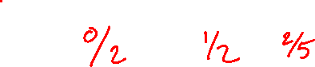
Naïve Bayes Classification - Example
If I get a new student with [GPA = 1.2, SAT = 550, ACT = 21], do we expect them to graduate (pos) or not (neg)?
ASSUME INDEPENDENCE
p(pos | 1.2, 550, 21) = p(1.2 | pos) * p(550 | pos) * p(21 | pos) * p(pos)
 | Pos | Neg | Neg | Neg | Pos | ???
GPA | 2.5 | 1.9 | 1.2 | 2.1 | 4.0 | 1.2
SAT | 1100 | 990 | 750 | 1100 | 1600 | 550
ACT | 21 | 12 | 16 | 21 | 36 | 21

Slide 91
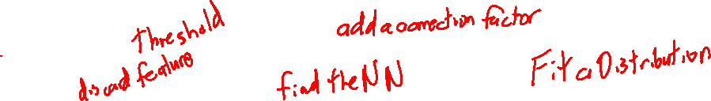
Overcoming Data Problems
We’ve never seen a student with an SAT of 550 before! How might you address this?
 | Pos | Neg | Neg | Neg | Pos | ???
GPA | 2.5 | 1.9 | 1.2 | 2.1 | 4.0 | 1.2
SAT | 1100 | 990 | 750 | 1100 | 1600 | 550
ACT | 21 | 12 | 16 | 21 | 36 | 21

Slide 92
Overfitting Solutions - Binning
Binning – Assign values to bins
Bins can vary in size, number, shape
- Equity concern?
 | Pos | Neg | Neg | Neg | Pos | ???
GPA | C | D | D | C | A | D
SAT | 1001-1400 | 751-1000 | 0-750 | 1001-1400 | 1401-1600 | 0-750
ACT | 21-25 | 11-15 | 16-20 | 21-25 | 31-36 | 21-25

Slide 93
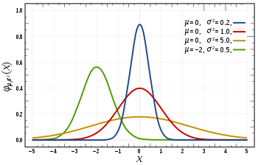
Overfitting Solutions – Increasing Sample Size
“If I just keep taking samples, surely I’ll eventually cover my whole sample space!”

Slide 94
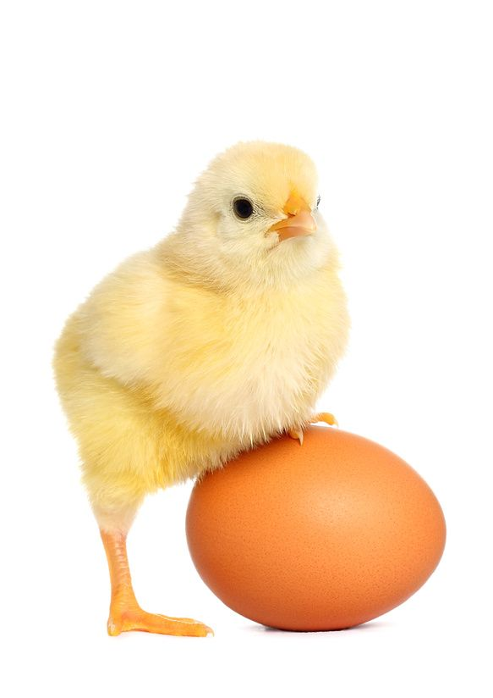
Overfitting Solutions – Targeted Sampling
“If I know to expect something, I can go seek out examples for training!”
 | Pos | Neg | Neg | Neg | Pos | ???
GPA | C | D | D | C | A | D
SAT | 1001-1400 | 751-1000 | 0-750 | 1001-1400 | 1401-1600 | 0-750
ACT | 21-25 | 11-15 | 16-20 | 21-25 | 31-36 | 21-25
Notes:
https://www.applicoinc.com/wp-content/uploads/2014/12/chicken-and-egg.jpg
https://cdn0.wideopenspaces.com/wp-content/uploads/2014/11/ftd-nimrodlion.jpg
https://cdn-images-1.medium.com/max/2600/1*9Z6W_yHevsq2jQZE9VK5rw.jpeg
https://i.redd.it/jc713jekk9901.jpg

Slide 95
Overfitting Solutions – Trust the Experts
Sometimes there could be databases or lists of interest to your problem, e.g. a “cutoff score” for SAT scores, or a “valence score” for NLP word connotations.
- Does it actually fit my problem space?
- Do I trust it?

Slide 96

Overfitting Solutions - Smoothing
Builds on the assumption that “nothing is impossible”
Notes:
https://media1.tenor.com/images/0a6182efc5ec93a6242b570f81394c0e/tenor.gif?itemid=11098164

Slide 97
Overfitting Solutions - Smoothing
Step 1) Start with a completely naïve, untrained understanding
- “a) All possible examples are equally likely to exist in my problem space and b) All classes are equally likely”
- All HS features are equally likely to appear in a student and all students are equally likely to be positive or negative
p(x) = 1 p(y) = 1
|V| |Y|

Slide 98
Overfitting Solutions - Smoothing
Step 2) Add our training cases to the evidence set
BEFORE
p(x|y) = p(x,y) = # positive grads with “x” in them
p(y) # positive grads
AFTER
p(x|y) = p(x,y) + 1 = # positive grads with “x” (found in training) + 1
p(y) +|V| # positive grads (in training) + tot. student options
Add-1 or Laplace Smoothing

Slide 99

Overfitting Solutions - Smoothing
Step 2) Add our training cases to the evidence set
BEFORE
p(y) = # positive students
# students
AFTER
p(y) = # positive students (found in training) + 1
# students (found in training) + total classes
Add-1 or Laplace Smoothing

Slide 100
Overcoming Data Problems
Binning + Smoothing
GPA: 5 Bins - A, B, C, D, F
SAT: 2 Bins - >600
ACT: 2 Bins - >25
 | Pos | Neg | Neg | Neg | Pos | ???
GPA | 2.5 | 1.9 | 1.2 | 2.1 | 4.0 | 1.2
SAT | 1100 | 990 | 750 | 1100 | 1600 | 550
ACT | 21 | 12 | 16 | 21 | 36 | 21

Slide 101
Naïve Bayes Classification
If I get a new student with [GPA = 1.2, SAT = 550, ACT = 21], do we expect them to graduate (pos) or not (neg)?
p(pos | 1.2, 550, 21) = p(D | pos) * p(- | pos) * p(Low | pos) * p(pos)
 | Pos | Neg | Neg | Neg | Pos | ???
GPA | C | D | D | C | A | D
SAT | + | + | + | + | + | -
ACT | Low | Low | Low | Low | High | Low

Slide 102
Naïve Bayes Classification
p(pos | 1.2, 550, 21) = p(D | pos) * p(- | pos) * p(Low | pos) * p(pos)
 | Pos | Neg | Neg | Neg | Pos | ???
GPA | C | D | D | C | A | D
SAT | + | + | + | + | + | -
ACT | Low | Low | Low | Low | High | Low

Slide 103
Naïve Bayes Classification
p(pos | 1.2, 550, 21) = p(D | pos) * p(- | pos) * p(Low | pos) * p(pos)
Add-1 Smoothing
p(x|y) = p(x,y) + 1 = # positive grads with “x” (found in training) + 1
p(y) +|V| # positive grads (in training) + tot. student options
p(y) = # positive students (found in training) + 1
# students (found in training) + total classes
 | Pos | Neg | Neg | Neg | Pos | ???
GPA | C | D | D | C | A | D
SAT | + | + | + | + | + | -
ACT | Low | Low | Low | Low | High | Low

Slide 104
Naïve Bayes Classification
p(pos | 1.2, 550, 21) = p(D | pos) * p(- | pos) * p(Low | pos) * p(pos)
= 1/7 * 1/4 * 2/4 * 3/7 = 3/392 or 0.0077ish
Add-1 Smoothing
p(x|y) = p(x,y) + 1 = # positive grads with “x” (found in training) + 1
p(y) +|V| # positive grads (in training) + tot. student options
p(y) = # positive students (found in training) + 1
# students (found in training) + total classes
 | Pos | Neg | Neg | Neg | Pos | ???
GPA | C | D | D | C | A | D
SAT | + | + | + | + | + | -
ACT | Low | Low | Low | Low | High | Low

Slide 105
Naïve Bayes Classification
p(neg | 1.2, 550, 21) = p(D | neg) * p(- | neg) * p(Low | neg) * p(neg)
Add-1 Smoothing
p(x|y) = p(x,y) + 1 = # negative grads with “x” (found in training) + 1
p(y) +|V| # negative grads (in training) + tot. student options
p(y) = # negative students (found in training) + 1
# students (found in training) + total classes
 | Pos | Neg | Neg | Neg | Pos | ???
GPA | C | D | D | C | A | D
SAT | + | + | + | + | + | -
ACT | Low | Low | Low | Low | High | Low

Slide 106

Naïve Bayes Classification
p(neg | 1.2, 550, 21) = p(D | neg) * p(- | neg) * p(Low | neg) * p(neg)
= 3/8 * 1/5 * 4/5 * 4/7 = 6/175 or 0.034ish
Add-1 Smoothing
p(x|y) = p(x,y) + 1 = # negative grads with “x” (found in training) + 1
p(y) +|V| # negative grads (in training) + tot. student options
p(y) = # negative students (found in training) + 1
# students (found in training) + total classes
 | Pos | Neg | Neg | Neg | Pos | ???
GPA | C | D | D | C | A | D
SAT | + | + | + | + | + | -
ACT | Low | Low | Low | Low | High | Low

Slide 107
Naïve Bayes - Probabilities
The probability of tweet x of length D being of class y
p(y|x) = p(y) * ∏_{i=1→D}(p(x_{i}|y))
We get some complicated, small numbers multiplication
- Theoretically valid
- We work with finite computing machines
- Leads to underflow
Let’s take the logarithm instead!

Slide 108
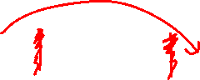
Naïve Bayes – Logarithms (ln)
Logarithm math refresher:
- ln(ab) = ln(a) + ln(b)
- ln(x) is monotonically increasing, so argmax() is still valid
y = argmax_{c} ln(p(c)) + ∑_{i=1→D}ln(p(x_{i}|c))

Slide 109
Decision Trees

Slide 110
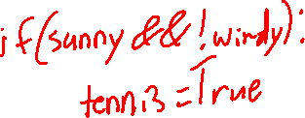
Machine Decision Making - 101
Think back to your very first days of programming…
I ask you to have a program take in two pieces of information:
- sun
- wind
And output whether or not I am going to play tennis.
- Only if it’s sunny and not too windy
What does this program look like?

Slide 111
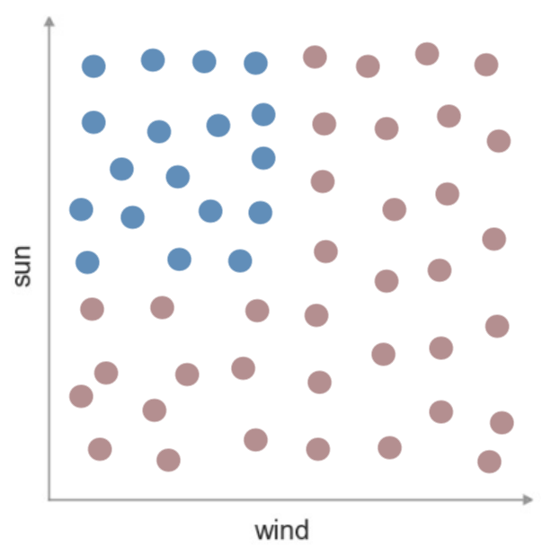
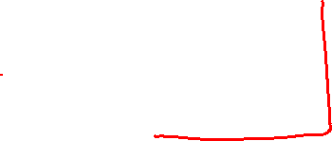
Machine Decision Making - Tennis
Consider this visualization of my data
And our model of a predictor
What would the decision boundary look
like here?

Slide 112
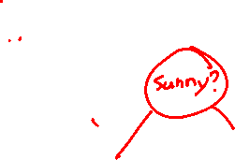
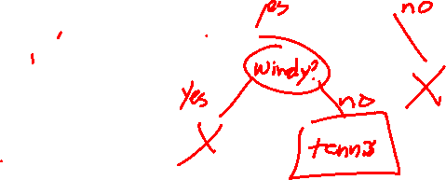
Machine Decision Making - 201
Think back to your very second days of programming (i.e. data structures)…
How might we represent a series of nested if/else statements?

Slide 113
Decision Trees
Creating nonlinear decision boundaries via the union of multiple linear decision boundaries
These are the basis of a lot of more complex algorithms – Stay Tuned

Slide 114
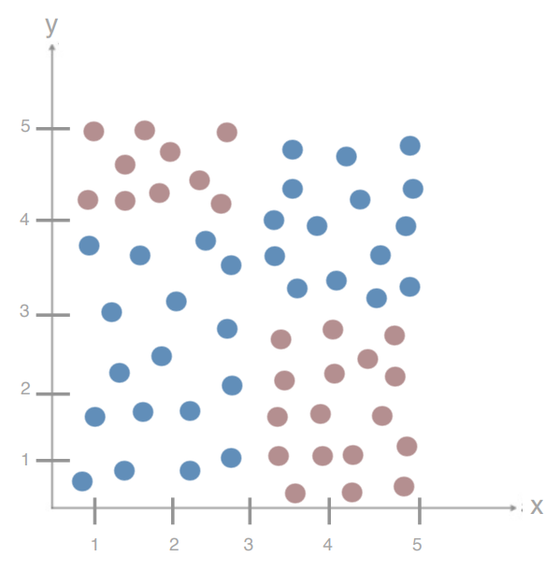
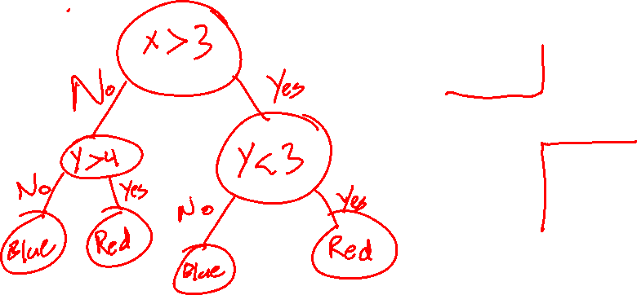
Decision Trees – Adding Complexity
What is my Decision Tree for this dataset?

Slide 115
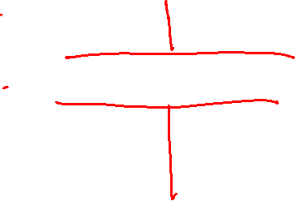
Decision Trees – Adding Complexity
What happens if I split on Y first?

Slide 116
Decision Trees – Adding Complexity
How do we decide the order of our splits?
How do we decide the location of splits?
With continuous variables?
How do we know we’re done?

Slide 117
Decision Trees – Choosing your Split
Simplifying our problem space – binary features
Test A | Test B | Test C | Cancer?
Pos | Neg | Neg | No
Pos | Pos | Neg | No
Neg | Pos | Pos | Yes
Pos | Neg | Pos | Yes

Slide 118
Decision Trees – Choosing your Split
What feature should I split on first?
Test A | Test B | Test C | Cancer?
Pos | Neg | Neg | No
Pos | Pos | Neg | No
Neg | Pos | Pos | Yes
Pos | Neg | Pos | Yes

Slide 119
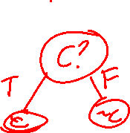
Decision Trees – Choosing your Split
What feature should I split on first?
What is my entire tree?
Test A | Test B | Test C | Cancer?
Pos | Neg | Neg | No
Pos | Pos | Neg | No
Neg | Pos | Pos | Yes
Pos | Neg | Pos | Yes

Slide 120
Decision Trees – Finding the Best Split
We need to find the split that gives us the best arrangement
We need to find the split that creates the most order from our chaos
Test A | Test B | Test C | Cancer?
Pos | Neg | Neg | No
Pos | Pos | Neg | No
Neg | Pos | Pos | Yes
Pos | Neg | Pos | Yes

Slide 121
Decision Trees - Entropy
A measure of the impurity / messiness / chaos of a set of examples

Slide 122
Decision Trees - Entropy
A measure of the impurity / messiness / chaos of a set of examples
∑_{c=1…n} -p_{c} * log₂(p_{c})

Slide 123
Decision Trees - Entropy
A measure of the impurity / messiness / chaos of a set of examples
∑_{c=1…n} [-p_{c} * log₂(p_{c})]
C for each possible class
In the binary case…
-p * log₂(p) – (1-p) * log₂(1-p)

Slide 124
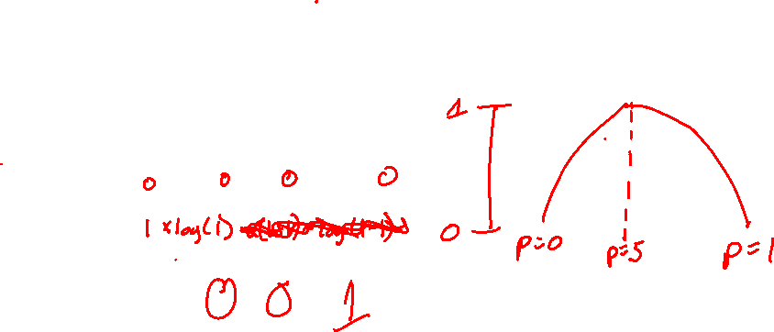
Decision Trees - Entropy
A measure of the impurity / messiness / chaos of a set of examples
Entropy = ∑_{c=1…n} [-p_{c} * log₂(p_{c})]
C for each possible class
In the binary case…
Entropy = -p * log₂(p) – (1-p) * log₂(1-p)
What happens at p = 1? p = 0? p = 0.5?

Slide 125
Decision Trees - Entropy
A measure of the impurity / messiness / chaos of a set of examples
Entropy = ∑_{c=1…n} [-p_{c} * log₂(p_{c})]
C for each possible class
In the binary case…
Entropy = -p * log₂(p) – (1-p) * log₂(1-p)
What happens at p = 1? p = 0? p = 0.5?
Minimum – perfect isolation of one class, Entropy = 0
Maximum – perfect split of data, Entropy = 1

Slide 126
Decision Trees - Entropy
A measure of the impurity / messiness / chaos of a set of examples
Entropy = ∑_{c=1…n} [-p_{c} * log₂(p_{c})]
C for each possible class
In the general case… (3 class case)
P_{c} = .33 for all c P = {1,0,0}
Entropy is maximized (~ 1.56) Entropy is 0
P₁ = .4 P₂ = .4 P₃ = .2
Entropy is reduced (~1.52)

Slide 127

Decision Trees – Entropy of Cancer
Entropy of our root node?
Test A | Test B | Test C | Cancer?
Pos | Neg | Neg | No
Pos | Pos | Neg | No
Neg | Pos | Pos | Yes
Pos | Neg | Pos | Yes

Slide 128
Decision Trees – Entropy of Cancer
Entropy of our root node?
-.5 * log₂(.5) - .5 * log₂(.5) = 1
Maximum Entropy
Test A | Test B | Test C | Cancer?
Pos | Neg | Neg | No
Pos | Pos | Neg | No
Neg | Pos | Pos | Yes
Pos | Neg | Pos | Yes

Slide 129
Decision Trees – Entropy of Cancer
How do we pick our split?
Choose the feature that reduces our entropy the most!
Test A | Test B | Test C | Cancer?
Pos | Neg | Neg | No
Pos | Pos | Neg | No
Neg | Pos | Pos | Yes
Pos | Neg | Pos | Yes

Slide 130
Decision Trees – Minimizing Entropy
We are creating a split to minimize the entropy of our set…

Slide 131
Decision Trees – Minimizing Entropy
We are creating a split to minimize the entropy of our set…
But really, we’re creating two sets, each with their own entropy, but a smaller number of samples in each.

Slide 132
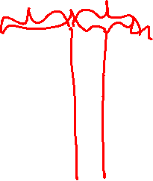
Decision Trees – Minimizing Entropy
We are creating a split to minimize the entropy of our set…
But really, we’re creating two sets, each with their own entropy, but a smaller number of samples in each.
Is it better to split evenly, or finely?

Slide 133
Decision Trees – Minimizing Entropy
We are creating a split to minimize the entropy of our set…
But really, we’re creating two sets, each with their own entropy, but a smaller number of samples in each.
What makes for a good split?

Slide 134

Decision Trees – Minimizing Entropy
We are creating a split to minimize the entropy of our set…
But really, we’re creating two sets, each with their own entropy, but a smaller number of samples in each.
D_{par} = Data found in Parent Node
D_{left} = Data found in Left Node
D_{right} = Data found in Right Node
I() = Impurity function (entropy)
x_{i} = feature for split

